Slide 1
Correlated Anomalous Pattern Mining from Transactional Cybersecurity Dataset
Maliha Momtaz

Slide 2
Objectives and Benefits
Capturing anomalous / infrequent correlated network traffic.
Capturing anomalous network traffic, which are likely to appear together.
Example,
{http, REJ, neptune}
{icmp, ecr_i, smurf}
{http, private}
Benefits:
Security people can take necessary steps beforehand.
Gives idea about type of attack.
Correlated anomalous / infrequent itemsets

Slide 3
Sample Transactional Cybersecurity Dataset (NSL-KDD)
TID | Items
T1 | http, SF, normal
T2 | http, SF, normal
T3 | SF, normal
T4 | SF, normal
T5 | icmp, ecr_i, SF, smurf
T6 | icmp, ecr_i, SF, smurf
T7 | tcp, http, REJ, neptune
T8 | http, private, REJ, neptune

Slide 4
NSL-KDD Dataset Description
Originated from KDD Cup 1999 dataset
Network traffic data from simulated computer network environment
Representative of real world cyber security scenarios
Two parts: kddtrain+ and kddtest+
42 features, 4 categorical and 38 numerical
Kddtrain+: 125973 rows, kddtest+: 22544 rows.
Numerical features:
number of source bytes,
number of destination bytes,
count of failed logged in attemts,
length of time duration of the connection etc.

Slide 5
NSL-KDD Dataset Sample Rows
0,tcp,http,SF,181,5450,0,0,0,0,0,1,0,0,0,0,0,0,0,0,0,0,8,8,0.00,0.00,0.00,0.00,1.00,0.00,0.00,9,9,1.00,0.00,0.11,0.00,0.00,0.00,0.00,0.00,normal.
0,tcp,private,REJ,0,0,0,0,0,0,0,0,0,0,0,0,0,0,0,0,0,0,111,8,0.00,0.00,1.00,1.00,0.07,0.07,0.00,255,8,0.03,0.07,0.00,0.00,0.00,0.00,1.00,1.00,neptune.
0,icmp,eco_i,SF,8,0,0,0,0,0,0,0,0,0,0,0,0,0,0,0,0,0,1,15,0.00,0.00,0.00,0.00,1.00,0.00,1.00,2,46,1.00,0.00,1.00,0.26,0.00,0.00,0.00,0.00,nmap.

Slide 6
NSL-KDD Categorical Features
Protocol | Service | Flag | Class
TCP (Transmission Control Protocol) | Private (within organization) | SF (successful connection) | Normal (no attack)
UDP (User Datagram Protocol) | HTTP (Hypertext Transfer Protocol) | REJ (rejected connection) | DoS (Denial of Service)
ICMP (Internet Control Message Protocol) | FTP (File Transfer Protocol) | …… | Probe (by port scanning)
 | SMTP (Simple Mail Transfer Protocol) | …… | R2L (unauthorized access to local networks)
 | ……… | …… | U2R (unauthorized access to root through software vulnerabilities)

Slide 7
NSL-KDD ‘Class’ Feature
DoS: back, land, neptune, smurf etc.
Probe: satan, ipsweep, nmap etc.
R2L: guess_password, imap, sendmail etc.
U2R: buffer_overflow, rootkit, perl etc.

Slide 8
Feature Selection from NSL-KDD
Selected categorical features only (protocol type, service, flag and class).
Deleted numerical features
Reason:
{255, tcp, http, private, 145}
{0, icmp, ecr_i, 1, smurf}
{476, private, REJ, 7564, neptune}
Can not be determined from which rows the numerical features are coming.

Slide 9
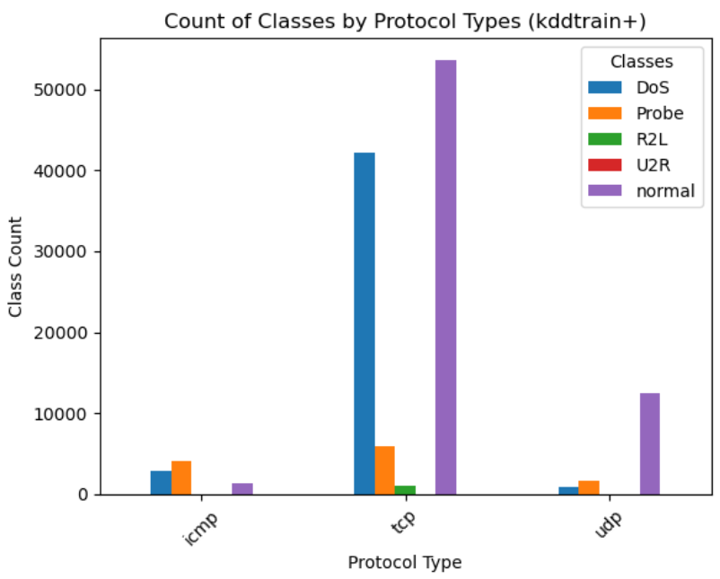
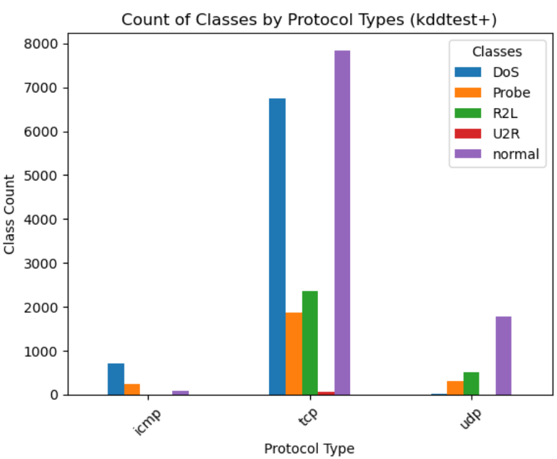
Protocol Type vs. Class Count

Slide 10
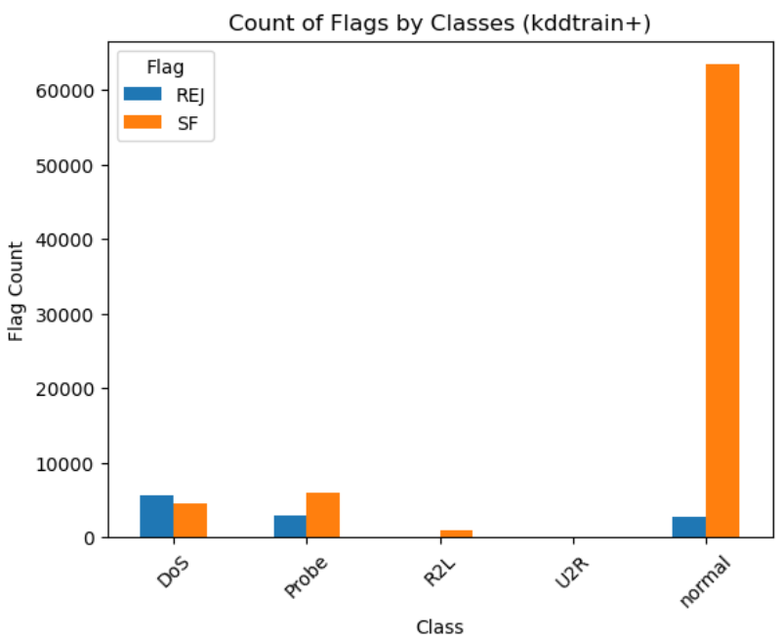
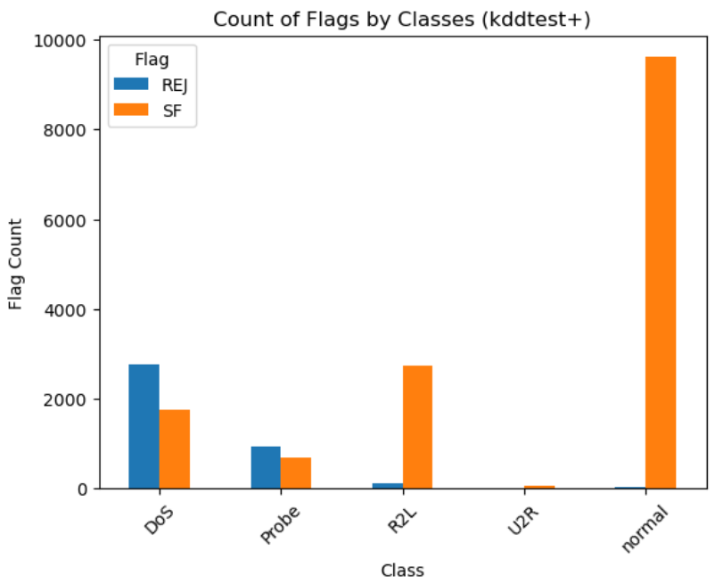
Class vs. Flag Count

Slide 11
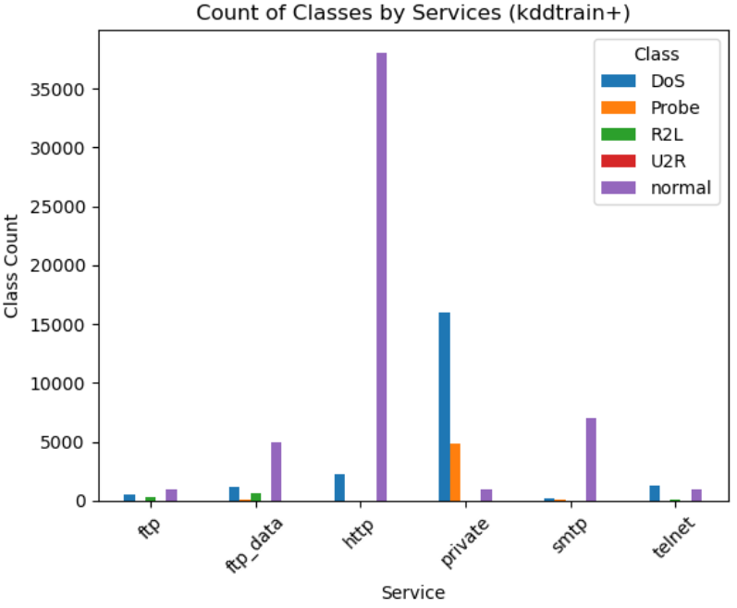
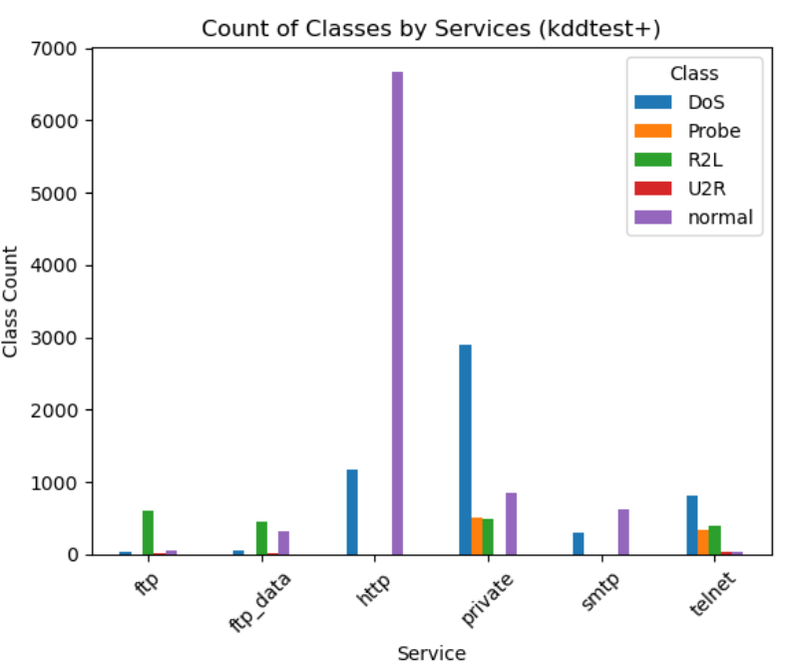
Service vs. Class Count

Slide 12
NSL-KDD Dataset
TID | Items
T1 | http, SF, normal
T2 | http, SF, normal
T3 | SF, normal
T4 | SF, normal
T5 | icmp, ecr_i, SF, smurf
T6 | icmp, ecr_i, SF, smurf
T7 | tcp, http, REJ, neptune
T8 | http, private, REJ, neptune

Slide 13
Support Count of items
Item | Support count
http | 4
SF
normal
icmp
ecr_i
smurf
tcp
REJ
neptune
private
Original dataset
TID | Items
T1 | http, SF, normal
T2 | http, SF, normal
T3 | SF, normal
T4 | SF, normal
T5 | icmp, ecr_i, SF, smurf
T6 | icmp, ecr_i, SF, smurf
T7 | tcp, http, REJ, neptune
T8 | http, private, REJ, neptune

Slide 14
Support Count of items
Item | Support count
http | 4
SF | 6
normal
icmp
ecr_i
smurf
tcp
REJ
neptune
private
Original dataset
TID | Items
T1 | http, SF, normal
T2 | http, SF, normal
T3 | SF, normal
T4 | SF, normal
T5 | icmp, ecr_i, SF, smurf
T6 | icmp, ecr_i, SF, smurf
T7 | tcp, http, REJ, neptune
T8 | http, private, REJ, neptune

Slide 15
Support Count of items
Item | Support count
http | 4
SF | 6
normal | 4
icmp
ecr_i
smurf
tcp
REJ
neptune
private
Original dataset
TID | Items
T1 | http, SF, normal
T2 | http, SF, normal
T3 | SF, normal
T4 | SF, normal
T5 | icmp, ecr_i, SF, smurf
T6 | icmp, ecr_i, SF, smurf
T7 | tcp, http, REJ, neptune
T8 | http, private, REJ, neptune

Slide 16
Support Count of items
Item | Support count
http | 4
SF | 6
normal | 4
icmp | 2
ecr_i
smurf
tcp
REJ
neptune
private
Original dataset
TID | Items
T1 | http, SF, normal
T2 | http, SF, normal
T3 | SF, normal
T4 | SF, normal
T5 | icmp, ecr_i, SF, smurf
T6 | icmp, ecr_i, SF, smurf
T7 | tcp, http, REJ, neptune
T8 | http, private, REJ, neptune

Slide 17
Support Count of items
Item | Support count
http | 4
SF | 6
normal | 4
icmp | 2
ecr_i | 2
smurf
tcp
REJ
neptune
private
Original dataset
TID | Items
T1 | http, SF, normal
T2 | http, SF, normal
T3 | SF, normal
T4 | SF, normal
T5 | icmp, ecr_i, SF, smurf
T6 | icmp, ecr_i, SF, smurf
T7 | tcp, http, REJ, neptune
T8 | http, private, REJ, neptune

Slide 18
Support Count of items
Item | Support count
http | 4
SF | 6
normal | 4
icmp | 2
ecr_i | 2
smurf | 2
tcp
REJ
neptune
private
Original dataset
TID | Items
T1 | http, SF, normal
T2 | http, SF, normal
T3 | SF, normal
T4 | SF, normal
T5 | icmp, ecr_i, SF, smurf
T6 | icmp, ecr_i, SF, smurf
T7 | tcp, http, REJ, neptune
T8 | http, private, REJ, neptune

Slide 19
Support Count of items
Item | Support count
http | 4
SF | 6
normal | 4
icmp | 2
ecr_i | 2
smurf | 2
tcp | 1
REJ
neptune
private
Original dataset
TID | Items
T1 | http, SF, normal
T2 | http, SF, normal
T3 | SF, normal
T4 | SF, normal
T5 | icmp, ecr_i, SF, smurf
T6 | icmp, ecr_i, SF, smurf
T7 | tcp, http, REJ, neptune
T8 | http, private, REJ, neptune

Slide 20
Support Count of items
Item | Support count
http | 4
SF | 6
normal | 4
icmp | 2
ecr_i | 2
smurf | 2
tcp | 1
REJ | 2
neptune
private
Original dataset
TID | Items
T1 | http, SF, normal
T2 | http, SF, normal
T3 | SF, normal
T4 | SF, normal
T5 | icmp, ecr_i, SF, smurf
T6 | icmp, ecr_i, SF, smurf
T7 | tcp, http, REJ, neptune
T8 | http, private, REJ, neptune

Slide 21
Support Count of items
Item | Support count
http | 4
SF | 6
normal | 4
icmp | 2
ecr_i | 2
smurf | 2
tcp | 1
REJ | 2
neptune | 2
private
Original dataset
TID | Items
T1 | http, SF, normal
T2 | http, SF, normal
T3 | SF, normal
T4 | SF, normal
T5 | icmp, ecr_i, SF, smurf
T6 | icmp, ecr_i, SF, smurf
T7 | tcp, http, REJ, neptune
T8 | http, private, REJ, neptune

Slide 22
Support Count of items
Item | Support count
http | 4
SF | 6
normal | 4
icmp | 2
ecr_i | 2
smurf | 2
tcp | 1
REJ | 2
neptune | 2
private | 1
Original dataset
TID | Items
T1 | http, SF, normal
T2 | http, SF, normal
T3 | SF, normal
T4 | SF, normal
T5 | icmp, ecr_i, SF, smurf
T6 | icmp, ecr_i, SF, smurf
T7 | tcp, http, REJ, neptune
T8 | http, private, REJ, neptune

Slide 23
Support Count of items
Item | Support count
http | 4
SF | 6
normal | 4
icmp | 2
ecr_i | 2
smurf | 2
tcp | 1
REJ | 2
neptune | 2
private | 1
max_support < 3
Original dataset
TID | Items
T1 | http, SF, normal
T2 | http, SF, normal
T3 | SF, normal
T4 | SF, normal
T5 | icmp, ecr_i, SF, smurf
T6 | icmp, ecr_i, SF, smurf
T7 | tcp, http, REJ, neptune
T8 | http, private, REJ, neptune

Slide 24
Ordered Items and Transactions
Ordered items:
ecr_i: 2, icmp: 2, neptune: 2, REJ: 2, smurf: 2, private: 1, tcp: 1.
[As many itemsets have similar support count, they are ordered alphabetically].
Ordered transactions:
TID | Items
T5 | ecr_i, icmp, smurf
T6 | ecr_i, icmp, smurf
T7 | neptune, REJ, tcp
T8 | neptune,private, REJ

Slide 25
Fp Tree Building
Inserting T5: {ecr_i, icmp, smurf}
root
TID | Items
T5 | ecr_i, icmp, smurf
T6 | ecr_i, icmp, smurf
T7 | neptune, REJ, tcp
T8 | neptune,private, REJ
ecr_i: 1
icmp: 1
smurf: 1

Slide 26
Fp Tree Building
Inserting T6: {ecr_i, icmp, smurf}
TID | Items
T5 | ecr_i, icmp, smurf
T6 | ecr_i, icmp, smurf
T7 | neptune, REJ, tcp
T8 | neptune,private, REJ
root
ecr_i: 2
icmp: 2
smurf: 2

Slide 27
Fp Tree Building
TID | Items
T5 | ecr_i, icmp, smurf
T6 | ecr_i, icmp, smurf
T7 | neptune, REJ, tcp
T8 | neptune,private, REJ
Inserting T7: {neptune, REJ, tcp}
root
ecr_i: 2
neptune: 1
icmp: 2
rej: 1
smurf: 2
tcp: 1

Slide 28
Fp Tree Building
TID | Items
T5 | ecr_i, icmp, smurf
T6 | ecr_i, icmp, smurf
T7 | neptune, REJ, tcp
T8 | neptune,private, REJ
Inserting T8: {neptune, private, REJ}
root
ecr_i: 2
neptune: 2
icmp: 2
rej: 1
private: 1
smurf: 2
tcp: 1
rej: 1

Slide 29
Item Header Tables with Head of Node Links..(remains)
root
ecr_i: 2
neptune: 2
icmp: 2
private: 1
REJ: 1
smurf: 2
REJ: 1
tcp: 1

Slide 30
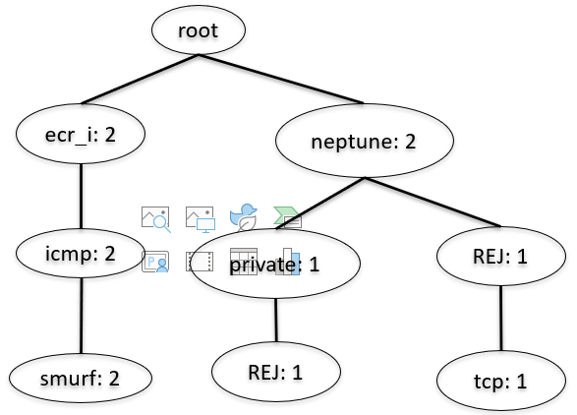

Mining Conditional Fp Trees and Anomalous Patterns
tcp:
root
Conditional pattern base:
(neptune: 1, REJ: 1)
Conditional Fp tree:
(neptune: 1, REJ: 1)
Anomalous patterns:
(tcp: 1),
(neptune, tcp: 1),
(REJ, tcp: 1),
(neptune, REJ, tcp: 1)
neptune: 1
rej: 1
tcp: 1

Slide 31
Mining Conditional Fp Trees and Anomalous Patterns
smurf:
root
Conditional pattern base:
(ecr_i: 2, icmp: 2)
Conditional Fp tree:
(ecr_i: 2, icmp: 2)
Anomalous patterns:
(smurf: 2),
(ecr_i, smurf: 2),
(icmp, smurf: 2),
(ecr_i, icmp, smurf: 2)
ecr_i: 2
icmp: 2
smurf: 2

Slide 32



Mining Conditional Fp Trees and Anomalous Patterns
REJ:
root
root
neptune: 1
neptune: 1
private: 1
rej: 1
Conditional pattern base:
{(neptune: 1, private: 1),(neptune:1)}
Conditional Fp tree:
(neptune: 2)
Anomalous patterns:
(REJ: 2),
(neptune, REJ: 2)
rej: 1

Slide 33

Mining Conditional Fp Trees and Anomalous Patterns
private:
root
Conditional pattern base:
(neptune:1)
Conditional Fp tree:
(neptune: 1)
Anomalous patterns:
(private: 1),
(neptune, private: 1)
neptune: 1
private: 1

Slide 34
Mining Conditional Fp Trees and Anomalous Patterns
neptune:
root
Conditional pattern base:
null
Conditional Fp tree:
null
Anomalous patterns:
(neptune: 2)
neptune: 2

Slide 35
Mining Conditional Fp Trees and Anomalous Patterns
icmp:
root
Conditional pattern base:
(ecr_i: 2)
Conditional Fp tree:
(ecr_i: 2)
Anomalous patterns:
(icmp: 2),
(ecr_i, icmp: 2)
ecr_i: 2
icmp: 2

Slide 36
Mining Conditional Fp Trees and Anomalous Patterns
ecr_i:
root
Conditional pattern base:
null
Conditional Fp tree:
null
Anomalous patterns:
(ecr_i: 2)
ecr_i: 2

Slide 37
Anomalous / Infrequent Itemsets
So, all anomalous / infrequent itemsets are:
(ecr_i: 2) (neptune, REJ, tcp: 1)
(icmp: 2) (ecr_i, smurf: 2)
(neptune: 2) (icmp, smurf: 2)
(REJ: 2) (ecr_i, icmp, smurf: 2)
(smurf: 2) (neptune, REJ: 2)
(private: 1) (neptune, private: 1)
(tcp: 1) (ecr_i, icmp: 2)
(neptune, tcp: 1)
(REJ, tcp: 1)
Only itemsets with size > 1 are considered for all correlation tests.

Slide 38
Anti-monotone Property
A property used to measure correlation between items of an itemset.
h_confidence value of an itemset (ab)
= support(ab) / max{support(a), support(b)},
where, support(ab) = number of times the items a and b appear together in a transactional dataset.
and
max{support(a), support(b)} chooses support(a), if support(a) > support(b). Otherwise, it chooses support(b).
If, h_confidence(ab) > h_conf. threshold, then (ab) satisfies anti-monotone property.

Slide 39
h_confidence example
The itemset (neptune, tcp) appears only once in a dataset.
So, support(neptune, tcp) = 1.
Also, given that,
support(neptune) = 2,
support(tcp) = 1
So, h_confidence(neptune, tcp) =
support(neptune, tcp) / max{support(neptune), support(tcp)}
= 1 / max{2, 1}
= 1 / 2
= 0.5

Slide 40

Anomalous Itemsets Satisfying Anti-monotone Property
Let’s assume, h_confidence threshold = 0.6
Itemset | h_confidence value | >= h_confidence threshold
(neptune, tcp) | 1 / 2 = 0.5
(REJ, tcp) | 1 / 2 = 0.5
(neptune, REJ, tcp) | 1 / 2 = 0.5
(ecr_i, smurf) | 2 / 2 = 1
(ecmp, smurf) | 2 / 2 = 1
(ecr_i, icmp, smurf) | 2 / 2 = 1
(neptune, REJ) | 2 / 2 = 1
(neptune, private) | 1 / 2 = 0.5
(ecr_i, icmp) | 2 / 2 = 1

Slide 41
Strong Affinity Property
Another property to test correlation.
Two measures: cosine and jaccard.
Only the itemsets which satisfy anti-monotone property will be tested for strong affinity property.

Slide 42
Cosine and Jaccard Rule
An itemset (ab) satisfies the cosine rule, if cosine(ab) >= h_confidence value(ab).
An itemset(ab) satisfies the jaccard rule, if jaccard(ab) >= {h_confidence value(ab) / 2}.
cosine(ab) = support(ab) / rootover{support(a) * support(b)}
jaccard(ab) = support(ab) / {support(a) + support(b) – support(ab)}

Slide 43
Cosine and Jaccard Example
The itemset (ecr_i, smurf) appear twice together in the transactional dataset.
So, support(ecr_i, smurf) = 2
Also, support(ecr_i) = 2 and support(smurf) = 2
So, cosine(ecr_i, smurf) = support(ecr_i, smurf) /
rootover{support(ecr_i) * support(smurf)}
= 2 / rootover(2 * 2)
= 1
jaccard(ecr_i, smurf) = support(ecr_i, smurf) /
{support(ecr_i) + support(smurf) – support(ecr_i, smurf)}
= 2 / (2 + 2 - 2)
= 1

Slide 44
Cosine and Jaccard Example
Itemsets which have more than two items in them, the average jaccard and cosine values have to be calculated for all pairs of items within this pattern.
For example, to derive the cosine and jaccard value of itemset (bcd), first all possible pair combinations have to be derived, which are (bc), (cd) and (bd).
Then, cosine(bc), cosine(cd) and cosine(bd) have to be calculated.
So, cosine(bcd) = {cosine(bc) + cosine(cd) + cosine(bd)} / 3.
Similarly, jaccard(bcd) = {jaccard(bc) + jaccard(cd) + jaccard(bd)} / 3.

Slide 45
Anomalous Itemsets Satisfying Cosine and Jaccard Rules
Itemset | h_confidence | h_confidence/2 | cosine | jaccard
(ecr_i, smurf) | 1 | 0.5 | 1 >= 1 | 1 >= 0.5
(icmp, smurf) | 1 | 0.5 | 1 >= 1 | 1 >= 0.5
(ecr_i, icmp, smurf) | 1 | 0.5 | 1 >= 1 | 1 >= 0.5
(neptune, REJ) | 1 | 0.5 | 1 >= 1 | 1 >= 0.5
(ecr_i, icmp) | 1 | 0.5 | 1 >= 1 | 1 >= 0.5

Slide 46
Ultimate Anomalous Itemset
So, highly correlated anomalous / infrequent patterns are:
(ecr_i, smurf: 2)
(icmp, smurf: 2)
(ecr_i, icmp, smurf: 2)
(neptune, REJ: 2)
(ecr_i, icmp: 2)

Slide 47
Experimental Results

Slide 48
Maximum Support vs. Time and Memory
kddtrain+: 125973 rows,
kddtest+: 22544 rows.

Slide 49
Maximum Support vs. Number of Frequent and Infrequent Itemsets
kddtrain+: 125973 rows,
kddtest+: 22544 rows.

Slide 50
Maximum Support vs. Number of Correlated Anomalies
kddtrain+: 125973 rows,
kddtest+: 22544 rows.

Slide 51
Conclusions and Future Works
Find a way to add numerical features into account and distinguish them.
Will try to make it more time and memory efficient.
Will implement other correlation algorithms (such as, lift) and compare them with existing ones.
Will run our algorithm on other available network traffic dataset and observer their performance.

Slide 52
Thank You!

